Slide 1

Course Title: Bangladesh Studies
Course Code : GE334
Topic : Digital Bangladesh
Thanjida Akhter (102-15-1030)

Slide 2
What is Digital Bangladesh?
Digital Bangladesh or Vision 2021 was the political manifesto of the Bangladesh Awami League party before winning the National Elections of 2008. It stands as a political vision of Bangladesh for the year 2021, the golden jubliee of the nation.
The main goal is for Bangladesh
To become a middle-income country where poverty will be drastically reduced.
Not only mean the broad use of computers.
It means the modern philosophy of effective and useful use of technology in terms of implementing the promises in education, health, job placement, poverty reduction etc.

Slide 3


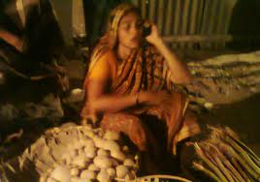
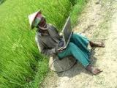
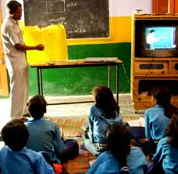
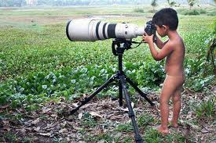
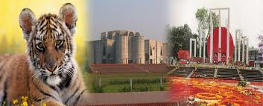

Slide 4
Bangladesh as we want to see in 2021
1. Democracy and effective parliament
2. Political framework, decentralization of power & people’s participation
3. Good governance through establishing rule of law and avoiding political partisanship
4. Transformation of political culture
5. A society free from corruption
6. Empowerment and equal rights for women
7. Economic development & initiative
8. Bangladesh in the global arena

Slide 5
Economic development & initiative
Meeting basic needs
Population and labour force
Alleviation of poverty
Food & nutrition
Health care
Education
Industry
Energy security
Infrastructural development
Housing
Environment
Water resources

Slide 6
Bangladesh in the global arena
Achievements of liberation
Culture
Foreign policy

Slide 7
Limitations for ensuring digital Bangladesh:
Lack of proper infrastructure of ICT
Lack of well trained manpower and training centre
Improper practice of ICT policy
Apathy of civil servants
Traditional attitude toward modern technology
Reactive manner of policy makers
Using closed based software
Insufficient facilities of LAN
Lack of visionary leadership quality
Poor English language skill
Patronizing corruption
Insufficient power supply
Lack of imagination of a good society
Lack of proper investment (national and international) in this arena

Slide 8
How can we ensure it in Bangladesh?
Developing proper infrastructure of ICT
Ensuring well trained manpower
Proper practice of ICT policy
Eagerness of civil servants
Proactive attitude toward modern technology
Innovative manner of policy makers
Using opened based software
Sufficient facilities of LAN
Ensuring visionary leadership quality
Developing English language skill
Patronizing ICT farms and scholars
Sufficient power supply
Image of a good society

Slide 9
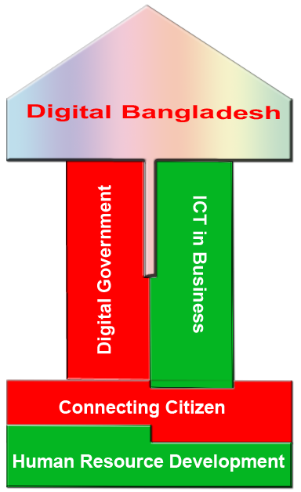
Thank You!

